Slide 1


Being a Sensory Detective
Children’s Occupational Therapy Service
Aneurin Bevan University Health Board

Slide 2
Why become a sensory detective?
Becoming a sensory detective will support you to identify and understand if there is a pattern presenting with the child/young person, and understand how they react to and respond to certain sensory information.
This may support you to plan for any inappropriate responses and allow you/others to deliver strategies to help the child/young person regulate the amount of sensory information they need, in order to respond as appropriately as they can.

Slide 3
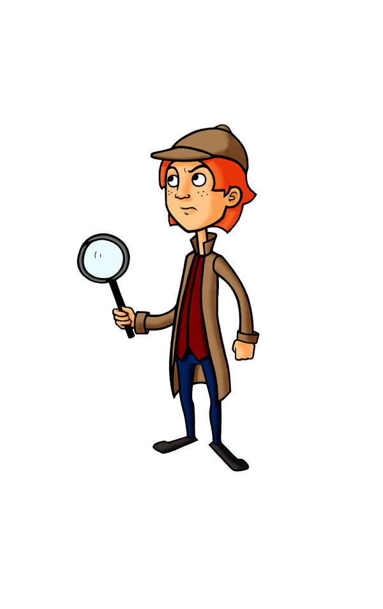
Where to start and what questions to ask?
Where?
When ?
Why?
How?
What?
Who?

Slide 4
Where to start?
When you observe a behaviour it is useful to ask yourself Why is the behaviour occurring ? Are there any triggers?
What are the sensory considerations? What are the behaviours?
Where is the behaviour happening? Is it the same in different environmental contexts? For example school or home.
When does this happen?, note the times and keep a record.
Who is there when it happens Is it Mum/Dad?, peers /school staff/ siblings?
How does it happen ? and describe what they do – you can use the tools in the following slides to help you record or map out your observations for example you can use an iceberg diagram or spider gram. These have been useful to lots of parents, school staff and others in the past
It is also helpful to ask yourself what is going on around the child/young person and with those close to them. What are your anxieties/ fears/feelings / sensory likes and dislikes ?

Slide 5
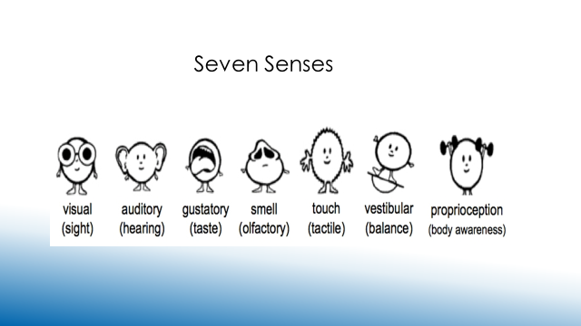
What are the Senses ?
And Interoception (the internal state of the body)

Slide 6
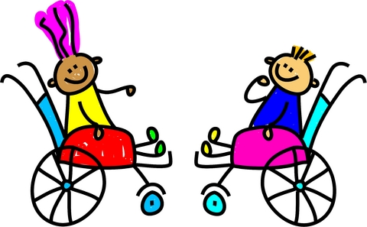

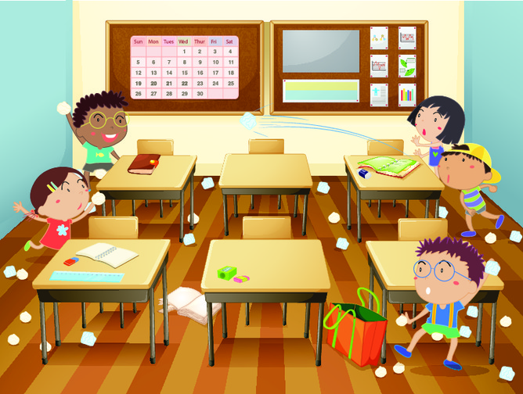

Behaviours
See behaviour think sensory but be mindful that not all behaviours mean that there are sensory reasons for the behaviours.
Other reasons for the behaviours:
Biological
Developmental
Communication
Environmental
Social / Relationships
Anxiety
Cognitive

Slide 7
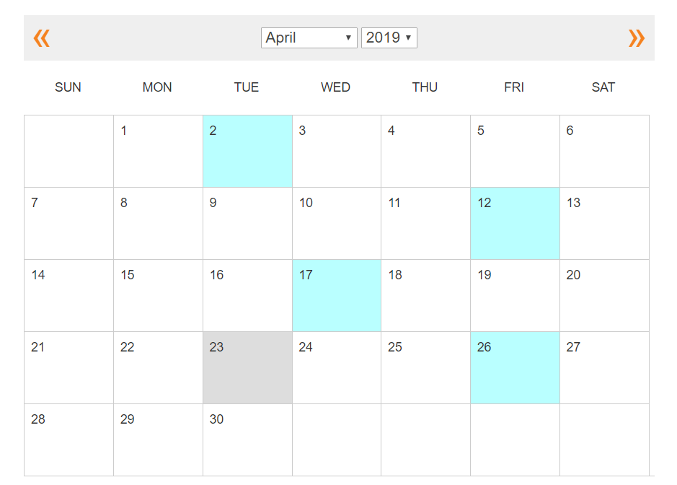



Look at all the behaviours and write them down.
Use the ABC model, A - Antecedents, B - Behaviour, C- Consequences.
Keep a record or video/ if its suitable for your child.

Slide 8
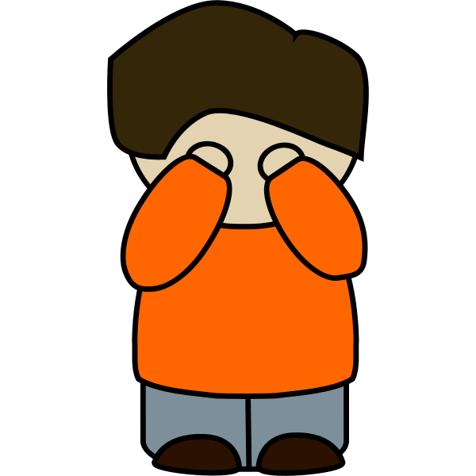
When you are identifying triggers also consider some of the following:
A-Antecedents -What was happening right before the behaviour who was there ?, what were the expectations?, what was going on in the environment in terms of their senses, seeing, hearing and touching?
B-Behaviour - What was the specific behaviour observed from the child? Think of time of day, have they eaten, are they anxious?
C-Consequences – What happened directly after the behaviour occurred

Slide 9


Example of Iceberg Diagram to use to record What you see? and Why?
WHAT?
What you see
Sensory processing
Learning difficulties
WHY?
Social anxiety
Not understanding the language
Motivation
Not able to communicate
Difficulty with change
ACES
Diagnosis
Difficulty understanding other people’s point of view
Anxiety
Developmental trauma

Slide 10

What can you do now you have investigated the difficulties/behaviours?
You may well understand how your child is trying to communicate and the difficulties they may have with communication. You may well have better insight into their cognitive abilities and if they have any difficulties.
If the child is experiencing physical difficulties or trauma then ensure that this is assessed by a professional.
Environment management or make changes to their environments.
Use behavioural strategies and positive behaviour support with them.
Reflect on your relationship and how you interact or are around your child,
What are your sensory preferences and how are you managing day to day?
Do you need any support?
Support attention, focus and regulation with specific strategies.
Seek advice and support from the web sites listed on his presentation.

Slide 11
Case Study
    An example of a young child that became upset in the lunch hall in school
What is happening?
The child is getting upset when he is entering the canteen to eat his lunch and becoming distressed.
The hall is noisy with lots of adults and children running around. There were lots of different smells from the food and a long queue with children standing in it .
Behaviours
The child was : Crying and Hiding under the table
Screaming and restless
Holding their hands over their ears
They refused to open their lunch and eat and drink their food
Disorientated
Consequences
They were calmer and more settled in a different room
They are able to settle and eat their food and have a drink
Distraction was used to support them by using their favourite books and they had access to sensory toys

Slide 12

Finding the pieces of the puzzle and building the bigger picture.

