Slide 1
Sensory Activities
Proprioception

Slide 2
Introduction
You have just heard about our 8 sensory systems and the proprioceptive system is one of these. Here are some activities which focus on the use of our proprioceptive system. Try some of these regularly within your child’s play to support their development.

Slide 3
Proprioceptive activities
You will remember that the proprioceptive system receives it information from our muscles and joints.
The following activities all focus on our muscles and joints:-
Weight-bearing activities
Heavy work & resistance
Movement
Deep pressure

Slide 4
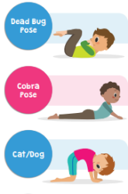
Weight-bearing activities
Yoga
Yoga poses help your child experience a range of positions, using different muscles and joints.
cosmic kids yoga link

Slide 5
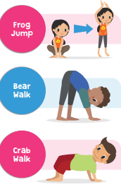
Weight-bearing activities
Animal walks
Can they walk like a crab, hop like a frog, slither like a snake or jump like a bunny? Encourage your child to think of an animal and move just like them!

Slide 6
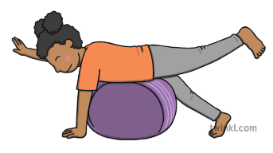
Weight-bearing activities
Gym ball activities
Exercise balls can be found in many shops and are a great way to provide proprioceptive input. Your child can sit on it, lie on their tummy or lie on their backs. Gently moving the ball whilst in those positions will really get those proprioceptors working!

Slide 7
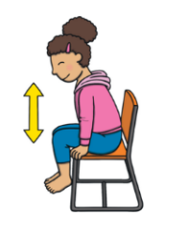
Weight-bearing activities
Chair push-ups
Lifting yourself up with your arms is an easy way to work your proprioceptors!
See if you can hold it there for a second or two!

Slide 8


Heavy work & resistance
Carrying heavy loads
Encourage your child to wear a backpack that has been filled with a few toys or books. You can also give them opportunities to help carry items within chores such as bags of shopping at the supermarket or laundry at home.

Slide 9
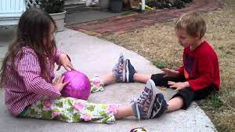
Heavy work & resistance
Weighted ball play
Play with a ball that has some weight to it. Take turns in rolling this on the floor back and fore to another person.

Slide 10
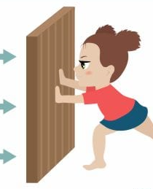
Heavy work & resistance
Wall pushes
Push-ups is another good way of working your arm, shoulder and back proprioceptors. These can be completed on the floor but they can also be done against a wall. Stand arm's length away from a wall, place your palms on the wall and whilst keeping your feet still bend your elbows and lean forwards towards the wall.

Slide 11
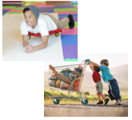
Heavy work & resistance
Pushing & pulling games
Try activities which involve pushing and pulling such as tug of war or pushing a shopping trolley around a shop.

Slide 12
Movement activities
Try getting your body moving in any way that you enjoy......running, jumping, climbing, dancing.....any exercise or sport will work your proprioceptors

Slide 13

Movement activities
Bouncing on a trampoline
Bounce on a trampoline. Try different ways of bouncing and maybe a few tricks like a star jump or a tuck jump (knees bent in towards your body).

Slide 14
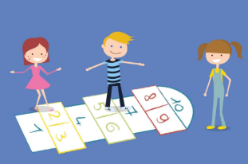
Movement activities
Jumping games & movement trails
Jumping games and movement trails. Try marking out hopscotch on the ground with chalk or jump over different small items placed on the floor....maybe set up an obstacle course which involves jumping over, crawling under or over.

Slide 15
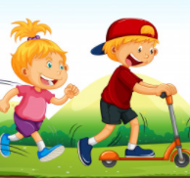
Movement activities
Running & scooting
Scooting or bike riding - start in a quiet big space and as confidence increases move to areas which require more control around corners.

Slide 16

Deep pressure
Tight hugs & deep pressure massage
Deep pressure gives firm input to muscles and joints. This can be applied by giving a big hug or a massage.

Slide 17
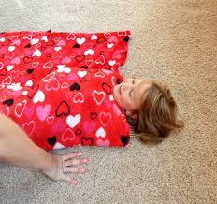
Deep pressure
Hot dog roll or blanket roll
Whilst lying on a blanket, roll them up to be tight like a sausage in a roll. Ensure their head is not covered by the blanket. Press down on them firmly with your hands or a therapy ball and pretend to 'squash tomato sauce' onto them.

Slide 18
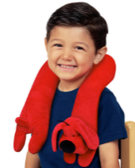
Deep pressure
Weighted wrap or pad
Using heavy soft toys or specially purchased weighted shoulder or lap wraps or pads is another way of targeting our proprioceptors. This can give a similar feeling to being hugged and can be comforting and calming

Slide 19
Things to consider
Make the activities fun!
Start with things your child enjoys
Encourage them to explore new activities, but never force them
Give them opportunities little and often

