Slide 1
Sensory Activities
Vestibular

Slide 2
What are sensory activities?
Sensory activities can be are used to support the child or young person to have a balanced amount of sensory information throughout the day in order to provide the right level of sensory input to support their regulation and function. We all need sensory information to stay calm and focused and the sensory activities can be integrated into everyday routines.
The following activities focus predominantly on the use of the vestibular system.

Slide 3
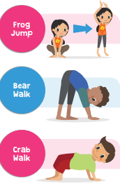
Calming activities
Animal walks

Slide 4
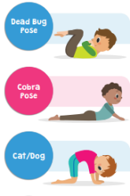
Calming activities
Yoga

Slide 5
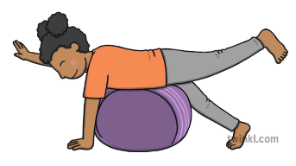
Calming activities
Gym ball games

Slide 6
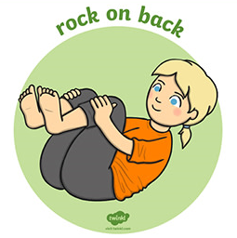
Calming activities
Rock and Roll

Slide 7
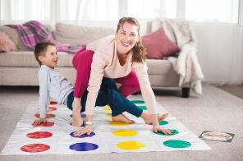
Alerting activities
Playing twister

Slide 8
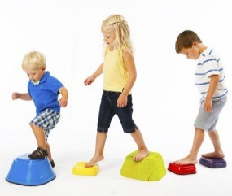
Alerting activities
Balancing activities

Slide 9

Alerting activities
Dance activities

Slide 10
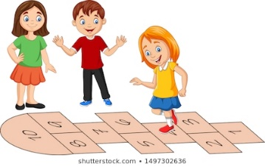
Alerting activities
Playground games

Slide 11
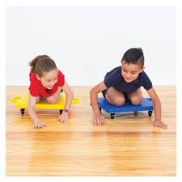
Wheels and things
Scooterboard/Skateboard games

Slide 12

Wheels and things
Skatepark

Slide 13

Wheels and things
Bike rides

Slide 14

Wheels and things
Skating

Slide 15

Playground activities
Swings

Slide 16
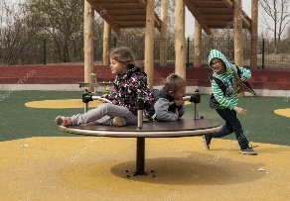
Playground activities
Spinning roundabouts

Slide 17
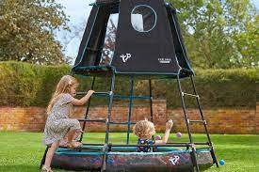
Playground activities
Climbing frames

Slide 18
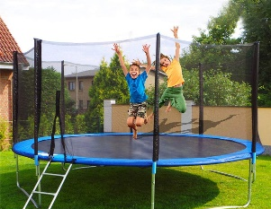
Playground activities
Bouncing on trampoline

Slide 19
Guidelines for using sensory activities
Watch the child’s behaviours and reactions at all times and if an activity is over arousing a child or under arousing them stop and do not continue. This is because too much sensory information may cause the sensory system to shut down or the child becomes over aroused.
Allow the child to be in charge of the activity as long as it is safe to do so. Sensory activities should be given under supervision of an adult.
Ensure that you prepare the child for the activity they are going to undertake using verbal or visual instructions as this will support them to learn the steps of the process.
Sensory information should be given over short periods of time.
Reflect on what the child was doing before and after the activity and does it make any difference to their performance.
Please only use the equipment provided for what its intended use is and follow instructions and the information.

