Slide 1



Sensory processing
Children’s Occupational Therapy Service
Aneurin Bevan University Health Board
Notes:
Brief explanation of OT

Slide 2

Aims
We have heard about our 8 sensory systems
Now we will think about how we process this sensory information
The aims for this presentation are;
To consider what we mean by sensory processing
To understand what sensory processing differences can look like and fell like

Slide 3

Our senses
VESTIBULAR
VISION
TASTE (gustatory)
SMELL
(olfactory)
PROPRIOCEPTION
TOUCH (tactile)
HEARING
INTEROCEPTION
Notes:
AIMS
Recap on 8 senses before explaining neurological thresholds
Label the 8 senses – animation – the pictures come up first, then click and the labels appear

Slide 4
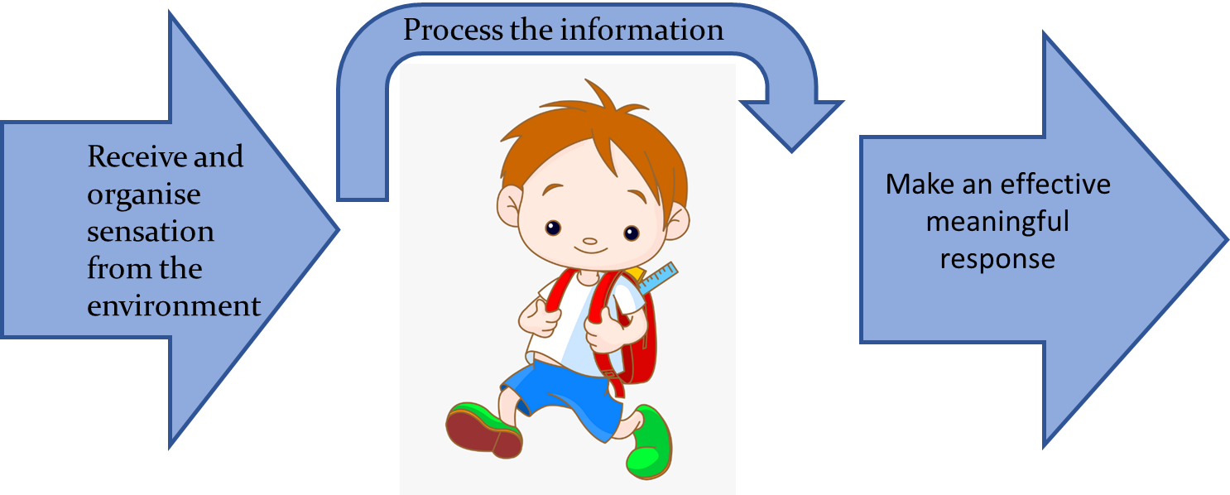
Sensory processing
Notes:
AIMS
-Explain sensory processing via the 3 areas
-Link this to the impact on occupations
-
•Brain processes information received from senses, organises it, and enables an appropriate response
•Our bodies and the environment send our brains information through the senses (input)
•We process and organise this information so that we feel safe and secure
•This helps to understand the world and respond appropriately (output) via emotions, thoughts or behaviour.
•
•Most of the time we process sensory information automatically without needing to think about it, although our responses are very individual to us (think of the activity).
•Our brains help us to prioritise, organise and understand the information so that we do not become overloaded.
•Think in terms of Receive, Process and Respond. E.g. Receive – I feel something in my hand. Process – the plate in my hand is very hot, it may hurt me, I need to put it down. Respond – put the plate down.

Slide 5
Sensory processing differences
Sometimes we have differences in our sensory processing
These differences could be just a collection of ‘quirks’ that make you who you are e.g. disliking labels in clothing which you have adapted to over the years. An individual may be able to overcome some of these themselves.
However, sometimes these differences can cause interruptions in daily life and adjustments need to be made.
Notes:
AIMS
Why would we be bothered, i.e. – occupational impact.
It is important to remember that these differences can be just who the child or person is – they do not impact on their day to day life. Many they may be able to overcome.
However, sometimes these differences can interfere with daily life and development, which is when we would be bothered about this.
It is important to look at sensory processing when thinking about helping a child to feel comfortable and secure. Some sensations may be distressing, but there may be other things that they show great enthusiasm for like spinning, playing with water and looking at wheels turn round.

Slide 6


Neurological thresholds
High threshold
Typical
Low threshold
Under responsive
Just right
Over responsive
Notes:
AIMS
To introduce neurological thresholds – over, under and typical. Why we aim for typical, but that there can be some fluctuation in us all.
Any sense can be any threshold in a child with sensory processing difficulty.
Problems can occur when we see a cluster of difficulties within a sensory system.
Explain that the brain is either happy or not happy with the threshold.
Introduce the concept of regulation.
So when we talk about sensory processing difficulties what do we mean. I am going to use this way of explaining it, hopefully it will make sense.
Thinking about our neurological threshold for sensory input. Remember we have those 8 senses, all receiving information, being processed and contributing to an outcome (what we see).
If we say there is a low neurological threshold – it does not take much information from that sense to elicit a response. So you have a very little cup and it fills up very quickly. It doesn’t take much to reach that threshold when it is registered.
If we say there is a high neurological threshold – you need a lot more information from the sense to register it. So you have a very big cup, which needs more to fill it up.
Any sense can be in any threshold. So a child may have a little cup for tactile (touch) and a big cup auditory.
Typical then falls within the middle. There may be fluctuations, but when you need to attend or learn you can. As an example from my day, I may start a bit under responsive, then as I wake up and get what I need (shower, food) I move more into the ready to go zone.
Give examples of this;
Tactile over responsive – sensitive
Vestibular under responsive – looking for movement opportunities

Slide 7
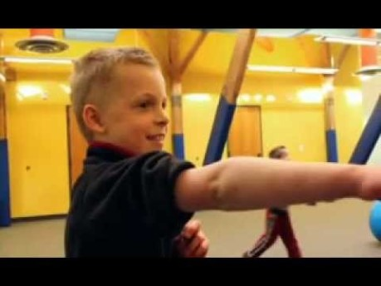
Neurological thresholds – big cup, little cup
Ref:
A Child's View of Sensory Processing - YouTube
Notes:
Play until 3:10
After video
The other aspect to mention is that you can be passive or active with you big or little cup, which we will explain a bit more over the next few slides.
Under responsive
– passive =registration/bystander
- active = seeking
Over responsive
- passive = sensitive
- active = avoider

Slide 8
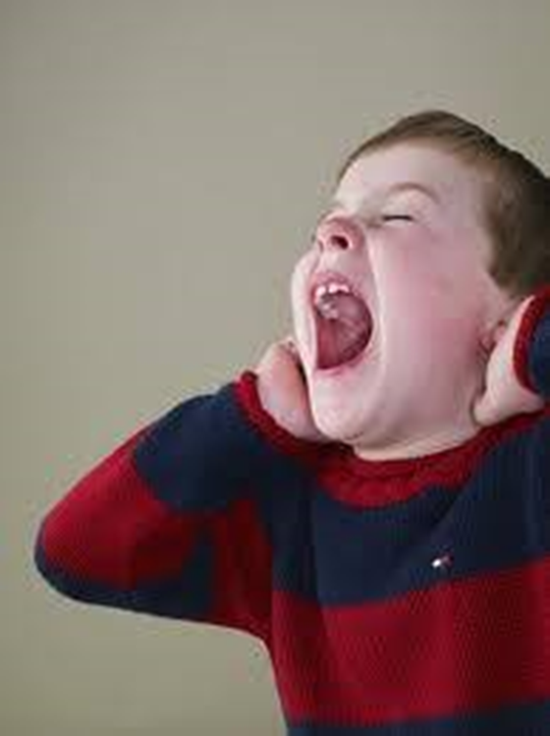
Over responsive
High threshold
Typical
Low threshold
Under responsive
Just right
Over responsive
Notes:
AIMS
To explain what over responsive looks like
Provide x drive resources
This is your little cup, so it does not take much sensory information to fill it up.
Too much information coming through :
If a child is oversensitive they may hear sounds that others can’t hear, show sensitivity to light, find certain textures uncomfortable or react strongly to other people touching them.
We may think of them as sensitive or defensive. Relatively harmless input can be interpreted as potentially harmful – eliciting a fight, freeze or flight response. E.g. gagging at the sight of a particular food, fear of falling if they have to close their eyes in the shower, people singing.
This can leads to sensory overload and meltdowns.

Slide 9
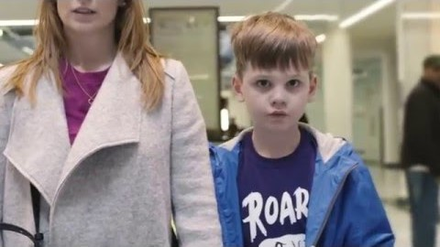
Over responsive
Ref:
National Autistic Society
Can you make it to the end? - YouTube
Notes:
AIMS
- Video explaining over responsiveness
NAS video – 1 minute, 24 seconds

Slide 10
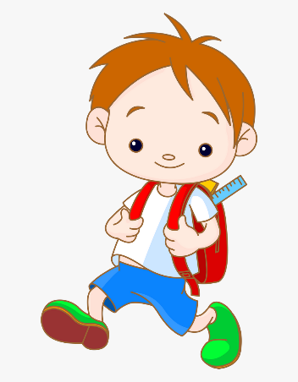
Over responsive example
Dislikes clothes labels, new school shoes, polo shirts around their neck
Avoids certain food textures
Cautious of new equipment, prefers feet on the floor, gets car sick
Becomes very upset during personal grooming tasks
Nervous with changes of floor surface, or going up/down stairs
May seek proprioceptive activities to calm/regulate
Notes:
AIMS
To reinforce previous slide

Slide 11
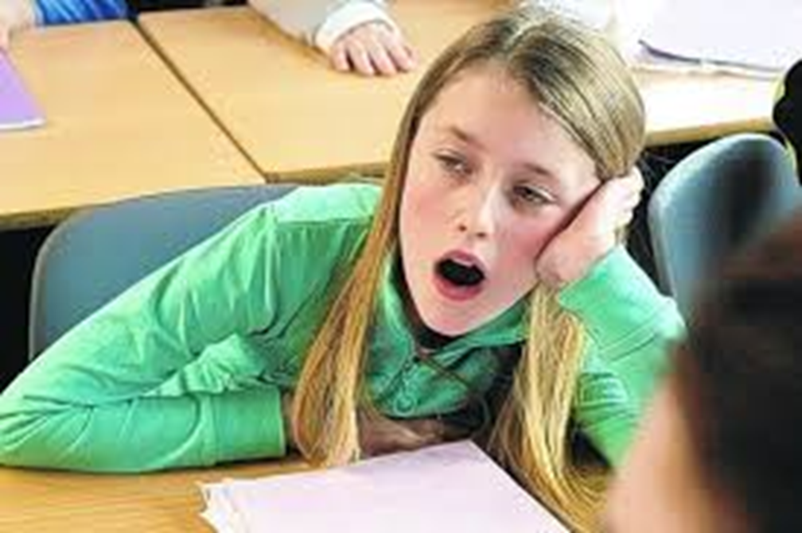
Under responsive
High threshold
Typical
Low threshold
Under responsive
Just right
Over responsive
Notes:
AIMS
To explain what under responsive looks like
Provide x drive resources
Very little input coming through:
If a child is under-responsive, may not notice noises around them or hear their name being called. May not appear to see things that other people do or may show a lack of awareness of other people by touching them or if they hurt themselves or get wet. They are ‘happy’ with their big cup.
May be more prone to sensory seeking to reach their thresholds. The are ‘unhappy’ with their big cups.

Slide 12
Under responsive example
Daydreamer, often a bystander or onlooker
Seeks out movement experiences and climbing – no fear!
Bumps into things, described as clumsy
Touches everything, smells everything, loves messy play!
Doesn’t notice if hands/face are dirty
Seeks out noises, lights to the point of it interfering
Notes:
AIMS
To reinforce previous slide

Slide 13
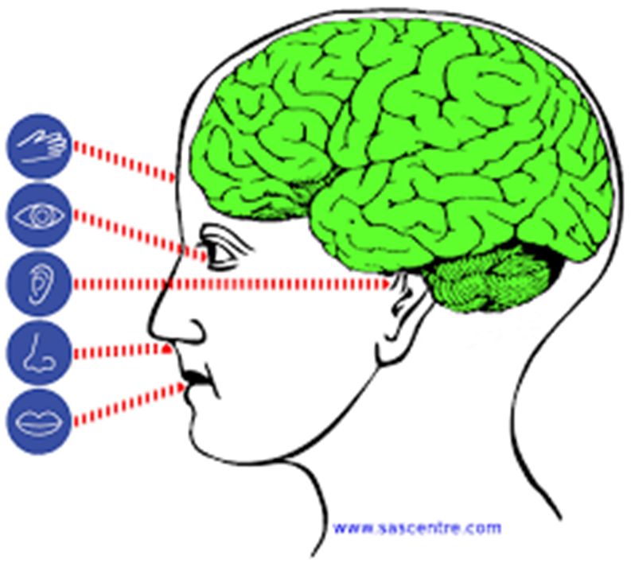
Filtering of information
Notes:
AIMS
- Discuss the role of filtering, and what it looks like when it is ineffective.
Also seen in the NAS film.
There is sensory input around us all the time and part of the role of sensory processing is to determine which input we need to pay active attention to and which to ignore.
If something goes wrong in this ‘processing’ bit then a child may not pay attention to the right things or can experience sensory overload.
For example - all the sounds around a child may seem at the same level, making it difficult to pick out the teachers voice and pay attention to him/her.
Or they might be getting information about how their clothes feel when trying to watch tv.
Typical processing would enable you to filter this out when you don’t need to attend to it.
…..This is a process called habituation
We do this without realising.
It is the process of adapting to sensory input after repeated presentations (example of clothes on in the morning, low traffic hum when trying to get to sleep).
When children have difficulties with this filtering - you may see them make adjustments to help them filter sensory input e.g. if they are listening to you then they can’t look at you. They may feel their clothes all day and not be able to shut off that feeling.
It is worth mentioning here that our nervous system is designed to keep us safe – so in a dangerous situation our brain will tell neurons to be more sensitive – so we can attend better, when there is a noise in the middle of the night we attend acutely. It our cortex which then can over-ride and say ‘that noise is safe’ and you don’t need to worry.
When we are in fight, flight or fright mode it is difficult to access your cortex to be reasonable – you are in your ‘primitive brain’. It is useful to consider when children may be in this state and how we help those who are frequently in this state to feel safer and calmer.

Slide 14
Sensory processing differences
Sensory processing differences can happen at any stage
Neurological thresholds – big cup, little cup
Filtering sensory information
Level of arousal
Notes:
AIMS
Re-cap computer analogy, filtering and where differences can occur
Just to re-cap before break, we have discussed;
Sensory processing differences can happen at any stage of the process. Receiving, Processing or Responding.
We consider the neurological thresholds for each sensory system – and is there a cluster of behaviours which indicates a difficulty and not just preferences/dislikes.
The filtering of sensory information is really important in our everyday life, if there is a difficulty here it can impact on a child’s learning and participation
We have talked about our level of arousal – and how we aim to be in that ‘just right’ state where we are able to attend, learn and function. Some people need help to manage their level of arousal – our tools to help with this are very individual. Managing this arousal level, or regulation is a whole other topic which is really interesting, but we don’t have time to chat about today.

Slide 15
Useful websites
Kids Matter. 2019. The Tactile System. Available at: https://youtu.be/trEVtjr6LLw
Sue Allen. 2019. Sensory Minis – Proprioception. Available at: https://youtu.be/Oquc160D1dw
Sue Allen. 2019. Sensory Minis – Vestibular. Available at: https://youtu.be/ueDQjhJDqIg
Lemon lime adventure
Facebook – The Zones of Regulation in Action
Notes:
ADD TO……

