Slide 1



Sensory regulation
Incorporating sensory experiences throughout the day to achieve a calm alert state
Children’s Occupational Therapy Service
Aneurin Bevan University Health Board

Slide 2
Aims
Understand the benefits of providing sensory input throughout the day
Gain practical knowledge of how sensory rich experiences can be provided in daily life
Understand how to provide the right sensory input for an individual so that they can achieve a calm alert state

Slide 3
Background knowledge required
Understanding of the 8 sensory systems
Knowledge of what it means to be a detective in relation to understanding the sensory needs of an individual

Slide 4
What is self-regulation?
The ability to change how we feel
Enables us to be at the optimum state of arousal for the demand, so we are alert yet relaxed enough to be ready to enjoy an activity
Affects how we interact with others and the environment
How are the sensory systems involved?
They impact how we feel and therefore our self-regulation
We can use them to support and change our self-regulation

Slide 5
Using a sensory approach to enable self regulation
In order to achieve in a task or activity a person needs to be in the right state of arousal
Using sensory input to help a person move to the correct state of arousal can help them to self regulate. Some children and young people need support to do this. Over time they may learn to use these strategies themselves.
We all create our own ways of supporting self-regulation to be in the “just right” state
Sensory diets refer to sensory based activities tailored to meet a person’s sensory based needs. A sensory diet is similar to what is being described here but is generally more prescriptive.
Notes:
Examples of sensory regulation: A baby crying, pick them up, cuddle, slow rhythmical rocking, softly sing, offer them a bottle – Calming
A sleepy young child needing to get ready for school. Say their name and alert them to the activities, gradually increasing the volume and speed of your voice, make the room brighter, put music on, encourage the child to move - Alerting

Slide 6
Sensory processing and sensory experiences
Sensory processing refers to the way we take in, make sense of and react to sensory input. E.g. hear a sound, work out whether we need to react, respond accordingly.
Sensory experiences – this refers to activities that we do which provide sensory input.

Slide 7
Incorporating sensory experiences throughout the day
It means giving a child opportunities for sensory input throughout their normal day at home or school
These sensory experiences should be easy to access
The sensory experiences fall into three categories
Alerting
- Organising
- Calming
Think about the individual when choosing activities. What is calming for one child could be alerting for another.
Also consider the time of day and adapt activities accordingly

Slide 8
Alerting activities
These are activities to help a child who is full of energy to focus or a passive child to get going
Spinning
Bouncing
Skipping
Jumping
Swinging
Bright lighting
Loud music
Strong smells
Crunchy food
Notes:
These activities stimulate the bodies central nervous system in preparation for demands.

Slide 9
Organising activities
These are activities to help an individual organise their body and plan their actions. Ideas include:
Heavy work – actively using muscles to gain proprioceptive feedback – digging, brushing up leaves, pulling a heavy trolley, cleaning a whiteboard
Resistance bands
Pushing against a wall or hands together
Massage or joint compressions
Rhythmic activities
Chewing or blowing
Vibrating pillows or massagers

Slide 10
Calming activities
These relax the nervous system to reduce anxiety, sensory defensiveness and fright, flight or fight reactions. Ideas include:
Soft lighting
Pop up tent or quiet corner
Bean bags
Rocking chair
Weighted equipment
Quiet music or white noise
Rocking slowly over a ball on tummy
Lay on the floor and roll a ball over the top for deep pressure

Slide 11
How can I incorporate sensory input into daily routines?
In order to be successful anything new needs to be easy to implement
Sensory input can be enhanced/changed simply and easily
Small changes done consistently may have a big impact

Slide 12
Morning – alerting activities to get going
Gradually introduce brighter lighting – open curtains half way.
Shower with strong smelling shower gel and rub dry with a towel.
Breakfast could include crunchy cereal or toast, chewy bagels, chewy cereal bar
Walk, cycle or scoot to school
Provide a fiddle toy in school
Sit on an air filled cushion during lessons
Running, climbing, swinging at break time
Drink through a straw, or sports bottle.
Provide a crunchy snack such as carrot or celery

Slide 13
Afternoon
Outdoor play at lunchtime, to include opportunities for a variety of sensations such as climbing, running, riding a trike, kicking a ball.
Opportunity to bounce over a peanut ball, do wall push ups, sit in a beanbag, experience deep pressure applied to shoulders
Bounce on trampoline on arrival at home, play with pets, play in the garden or carry out some organising and calming activities indoors.

Slide 14
Evening – a time to wind down and use calming activities
Listen to calm music with low lighting
Calming massage using firm strokes
Roll a ball over body in lying
Lie under a heavy blanket
Soothing bath and firm cuddle while wrapped in a soft towel with gentle rocking

Slide 15
Sensory circuits – these can be a good way of providing structured activities which provide a variety of sensory input
Set up activities to last 5-10 minutes
Begin with alerting activities – e.g. bouncing on a trampoline, jumping on the spot, swinging
Move on to some heavy work organising activities e.g. crawling through a tunnel, throwing a ball through a hoop, wall push ups
Finish with calming activities – sitting to make shapes with playdough, wrap up in a body sock, linear swinging
Useful to help with transitions e.g. arrival at school, arrival at home after school.

Slide 16

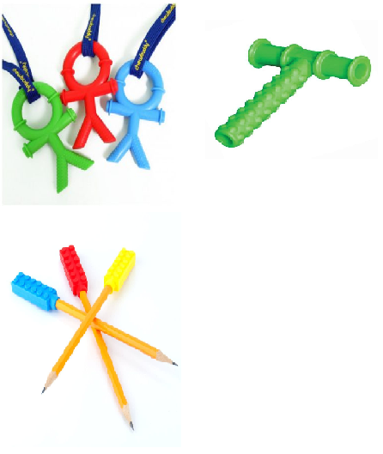
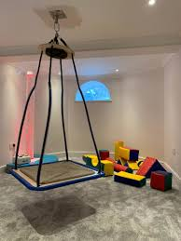
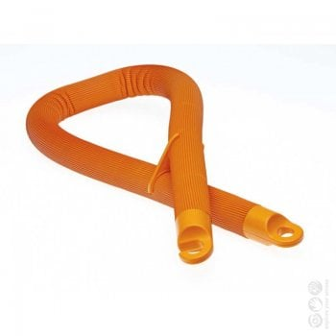
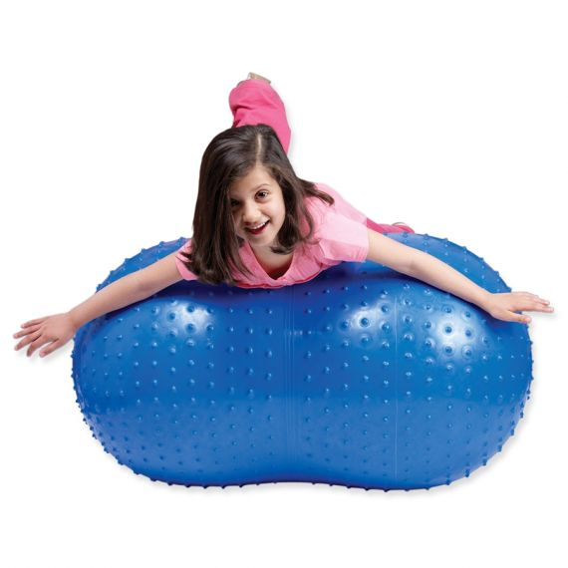
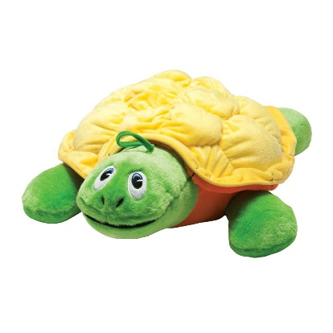
Photos of sensory resources
Weighted
Lap Pad
Vibrating
Snake &
Turtle
Platform Swing
Chewelry & Chewy Pencil Toppers
Massage Peanut Ball
Massage Peanut Ball

Slide 17
Link to sensory circuit video
https://www.bing.com/videos/search?q=you+tube+sensory+circuit+video&&view=detail&mid=632037731150D0611BFF632037731150D0611BFF&&FORM=VDRVSR
How to create a sensory circuit – YouTube

Slide 18
Key considerations
Be a detective
Trial and error – some children will benefit more from some activities than others
Regular sensory input required throughout the day – top ups may be needed e.g. movement break
Use and adapt things you already have, be creative

