Slide 1
Sensory Regulation

Slide 2
Sensory Regulation
Self -regulation allows people to maintain an appropriate ‘just right’ level of alertness in order to respond appropriately. It relates to the ability of a person to increase or decrease alertness, or arousal, to match the situation or environment. Sensory regulation strategies use the senses to help with regulation.
There are a number of ways to describe the different levels of alertness. We have based ours on the format by Sensory Ladders www.sensoryladders.org

Slide 3
Sensory Ladder
Freeze
Above overalert
Shut down or dissociated
Moving into flight or fight mode
Lots of adrenaline
Can be irritable of angry
Overalert
Able to think, plan and do
Will learn and remember best in this state
Calm & alert
Comfy/chilled or listless/bored
Awake but not all the brain is fired up
Underalert
Sleep
Below underalert
Dozy, sleepy or sleeping

Slide 4

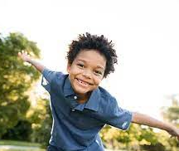
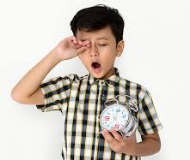
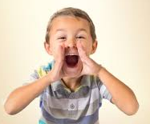
Self-regulate
In order to self-regulate we first need to know “Where am I at?”. We need to be able to recognise what level of alertness we are at before recognising we may need to do something different to move to a different level of alertness. Using visual aids can help support someone to develop this awareness. Everyone will have their own feelings and description of themselves at each level so these should be made to reflect each person individually.

Slide 5
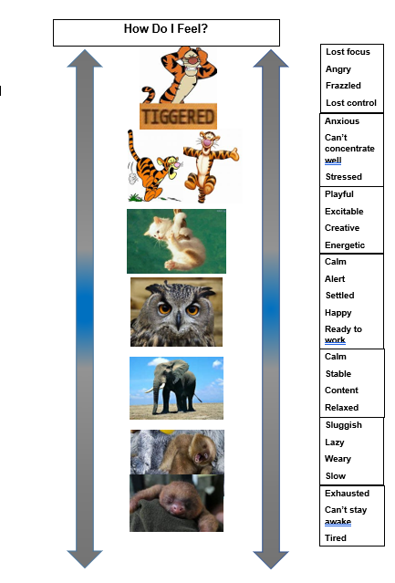
Here is an example:

Slide 6
Sensory activities
Having an awareness of which sensory activities are calming or alerting can be useful in supporting people to identify what they may need to do to help them to move from one level of alertness to another.
Please note that these suggestions are based on general principles, there is not a ‘one-size fits all’ and what is calming or alerting for one person isn’t necessarily the same for another person.

Slide 7
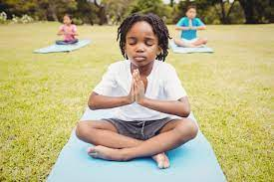
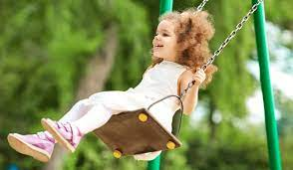
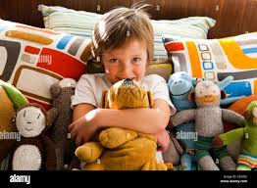
Sensory activities
Calming
Think of the principles of having a massage – slow, rhythmical firm pressure with low lighting and quiet music.
Soft lighting
Preferred music or white noise
Slow breathing
A quiet corner/area, perhaps a pop-up tent which is free from lots of sensory stimuli
Comfy soft seating, such as bean bags, big cushions, blankets
Rocking - slowing and rhythmically in a chair, on a swing, hammock, on tummy over a ball
Deep pressure - Hugging with a parent/ sibling/ partner or a favourite soft toy

Slide 8
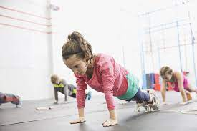
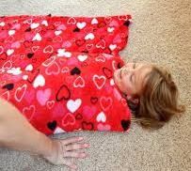

Sensory activities
Calming
Tightly wrapping your arms around your torso and/or crossing your legs and/or squeezing your hands together
Cuddling with a pet
Doing push ups on the floor or against a wall
Pushing into a chair with hands on the sides; holding self above chair with both arms; doing chair push-ups
Rolling up tightly in a blanket/sleeping bag
Carrying books or other heavy objects across a room or up and down the stairs (either using hands or wearing a back-pack)
Pushing and pulling heavy items
Taking a warm bath or shower
Using calming scents such as lavender and/or rose in oils, soaps, lotions, or candles

Slide 9
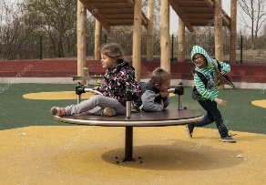
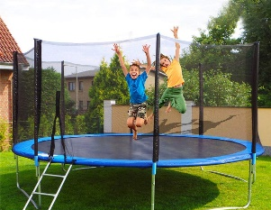
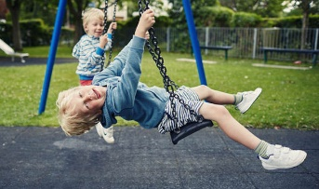
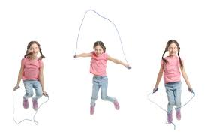
Sensory activities
Alerting
Spinning
Bouncing
Skipping
Jumping
Swinging
Bright lighting
Loud music
Strong smells
Crunchy food

Slide 10

Sensory activities
When a person is developing their ability to self-regulate, you can support them by suggesting and offering suitable activities to help them move between levels of alertness.
We have already highlighted that everyone is different, and the aim is for each individual to be able to identify what they need to do to self-regulate. It can however be useful to think about the typical levels of alertness in a child's day and the type of activities which may support them.

Slide 11
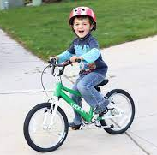

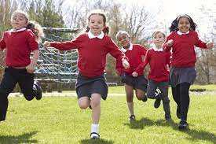
Sensory activities
Morning – alerting activities to get going
Gradually introduce brighter lighting – open curtains half way.
Shower with strong smelling shower gel and rub dry with a towel.
Breakfast could include crunchy cereal or toast, chewy bagels, chewy cereal bar
Walk, cycle or scoot to school
Provide a fiddle toy in school
Sit on an air-filled cushion during lessons
Running, climbing, swinging at break time
Drink through a straw, or sports bottle.
Provide a crunchy snack such as carrot or celery

Slide 12
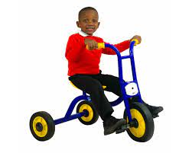
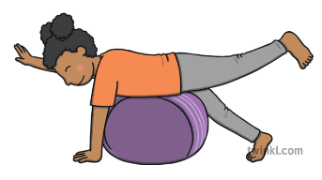
Sensory activities
Afternoon – a time to recharge
Outdoor play at lunchtime, to include opportunities for a variety of sensations such as climbing, running, riding a trike, kicking a ball.
Opportunity to bounce over a peanut ball, do wall push ups, sit in a beanbag, experience deep pressure applied to shoulders
Bounce on trampoline on arrival at home, play with pets, play in the garden or carry out some organising and calming activities indoors.

Slide 13
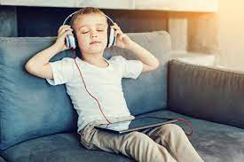
Sensory activities
Evening – a time to wind down and use calming activities
Listen to calm music with low lighting
Calming massage using firm strokes
Roll a ball over body in lying
Lie under a heavy blanket
Soothing bath and firm cuddle while wrapped in a soft towel with gentle rocking
You may have heard about sensory circuits or sensory diets. There are some similarities of these with the information above but they tend to be more prescriptive and are often not used flexibility or in response to an individual’s regulation at that moment in time. This link explains how a sensory circuit can be created How to create a sensory circuit - YouTube

Slide 14
Other sources of information
www.sensoryladders.org
www.griffinot.com
www.alertprogram.com
www.zonesofregulation.com

