Slide 1


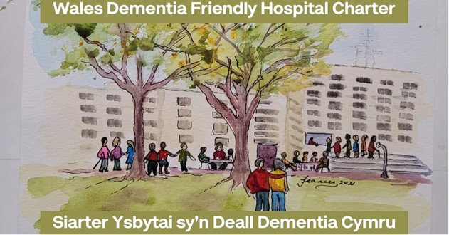
Amanda Whent
Lead Nurse for Dementia
17th May 2022

Slide 2

Welsh Government Dementia Action Plan for Wales, 2018-2022.
Risk reduction and delaying onset.
Raising awareness and understanding.
Recognising and Identification.
Assessment and Diagnosis.
Living well as possible, for as long as possible with Dementia.
The need for increased support.

Slide 3

Dementia care Pathway
Developed by Improvement Cymru Delivery Framework.-
Three priorities.
2-year scoping/1800 people, carers and partners
Focus on people living with dementia identified would make a difference
100 standards/20 Standards
2-year Delivery Framework 2021–2023
Of
Standards
Notes:
100 standards narrowed down to 20
People living with dementia
Carers and partners
7 HB regions / WAST
Dementia friends and carers groups
Mental health practitioners
Social care practitioners
Royal College of Psychiatry
General / acute care professionals
UK Dementia Congress
Wales Hearing Loss Conference
Alzheimer's Society UK & Wales
3Nations Network
Carers Trust & Carers Wales
DEEP
NHS Scotland
Professional leads – Nursing / AHP
Social Care Wales
Delivery Unit
TIDE
Welsh & English Universities
Health Inspectorate Wales

Slide 4
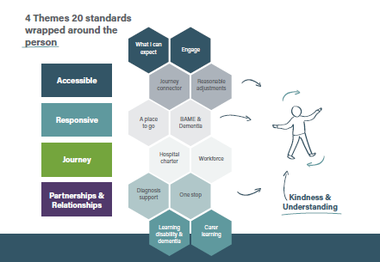
Notes:
Each standard applies to all people being assessed, diagnosed and living with dementia and their carers recognising dementia as a vulnerable group, together with individuals with special characteristics such as Learning Disability, Black, Asian and Minority Groups

Slide 5
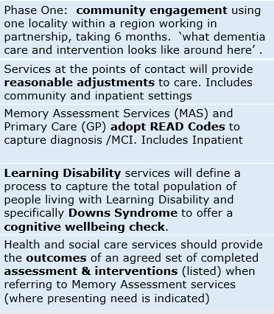
Standard Descriptors
Standards
1-5

Slide 6
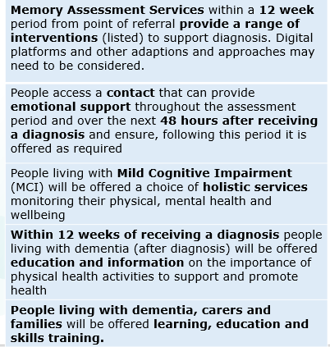
Standard Descriptors
Standards
6-10

Slide 7
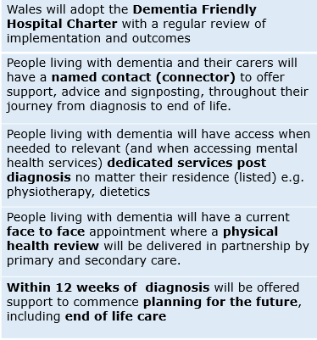
Standard Descriptors
Standards
11-15

Slide 8
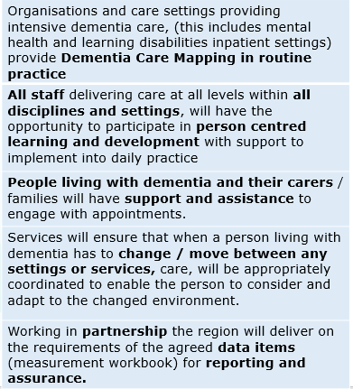
Standard Descriptors
Standards
16-20

Slide 9
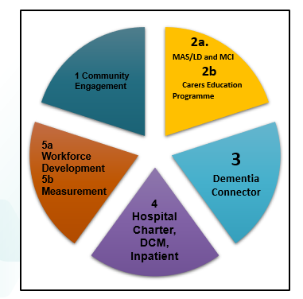
National Workstreams

Slide 11
Charter Aims
National ‘Premier’- 6th April 2022
Clear Statement of Key Principles that contribute to a Dementia Friendly Hospital
Informs people, carers and staff what they should expect
Fundamental Aims: to support wards to implement person centred dementia practice

Slide 12
Feedback From
“The Charter will improve the experience of people affected in hospital care settings.
An experience that recognises their personhood, diversity and preferences shaped by recognising the importance of dignity, respect and kindness”.
Mr AH.
Person Living with Dementia

Slide 13
Actions Taken
Revised Regional Dementia Action Plan to reflect the standards
In the process of forming the Regional Workstreams
Revised In-Patient Hospital Group Action Plan -Pilot of VIPS tool
Actions Needed: We need your help !
‘Expert by Experience’ Groups.
Feedback from people living with dementia and their carers/families must be used to transform services and improve people's lives.
and
Actions Needed

Slide 14

Thank you
Questions to the Panel
For more info Contact email:
abb.pcctdementia@wales.nhs.uk

