Slide 2
81M
Sudden onset headache early hours of morning
Chest pain radiating to right arm later in the day
Pain worse on inspiration
Grey/ clammy
Mottled
Reduced GCS- transient
Further similar episodes at handover to ED

Slide 3
PMH:
  Bronchiectasis
  BPH
  HTN
  OA
Independent ADL’s

Slide 4
Examination
JVP raised 6cm
Peripherally shutdown
Quiet breath sounds in general

Slide 5
ECG

Slide 6
EDUSS
Aorta max 2.5cm
Pericardial effusion

Slide 7
Plan?

Slide 8
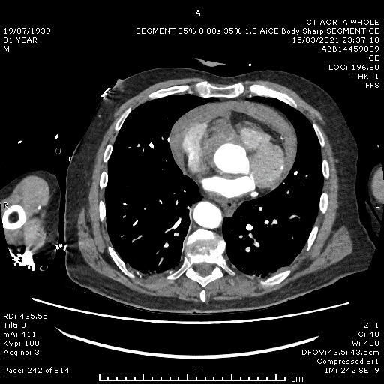

Slide 9
CT aorta:
Type A dissection
Haemopericardium

Slide 10
Next steps
D/W Cardiothoracics (15/3/21)
  Unlikely to survive surgery
  Palliative treatment
  Admitted GUH (medical assessment)

Slide 11
  17/3/21- stable and improved
  Re-discussed and transferred to Llandough hospital

Slide 12
17/3/21- transfer
18/3/21- repatriated
19/3/21- discharged home
20/4/21- DN’s requested to do bloods at home!!!

Slide 13
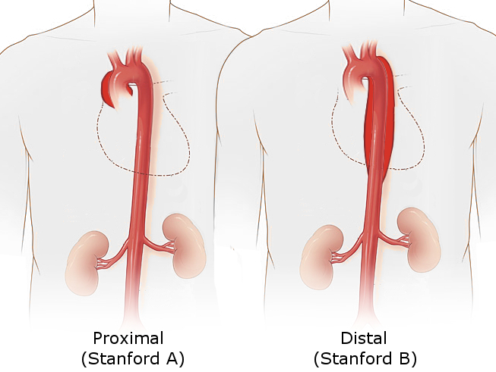
Stanford Classification
Type A- Ascending
  Worse prognosis
  Surgical management
Type B- Descending
  Uncomplicated- medical management

Slide 14
Surgery v Conservative treatment
Retrospective case review
Patients over 80 with Type A dissection (n=1690)
Surgery v conservative treatment
Death in hospital
Event free survival
Hospital mortality 15.6% v 51.1%
Event rate 37.2% v 36%

