Slide 1
20
A previously well 50 year old man presents with sudden onset, severe sharp chest pain, maximal at onset.
What is the most likely diagnosis?
Aortic dissection ( Clinically 3 times more common than AAA rupture)
Retrosternal chest pain, classically anterior dissection
Interscapular pain, classically descending aorta
severe pain 90% / sudden onset 90% / sharp 64% / tearing 50% / migrating 16% / Down the back 46%
End organ symptoms (neurological, syncope, seizure, limb parasthesias, CVA Sx, ﬂank pain, SOB)
Aortic regurgitation / HTN
ANSWER:

Slide 2
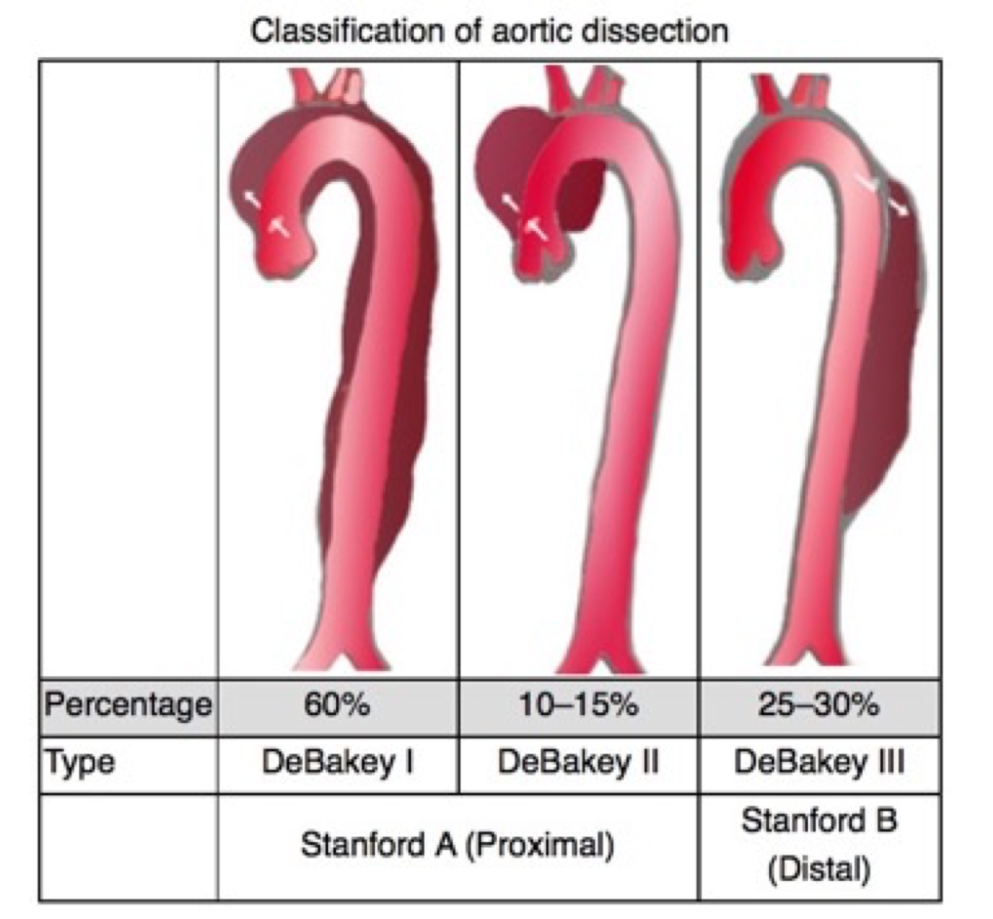
20
How do we classify aortic dissection?
ANSWER:
Stanford
Type A - ascending aorta involved, surgery needed
Type B - aorta beyond left subclavian artery, can be medically managed
DeBakey
1 - entire aorta
2 - conﬁned to the ascending aorta
3 - Descending aorta distal to the subclavian artery
REVEAL:

Slide 3
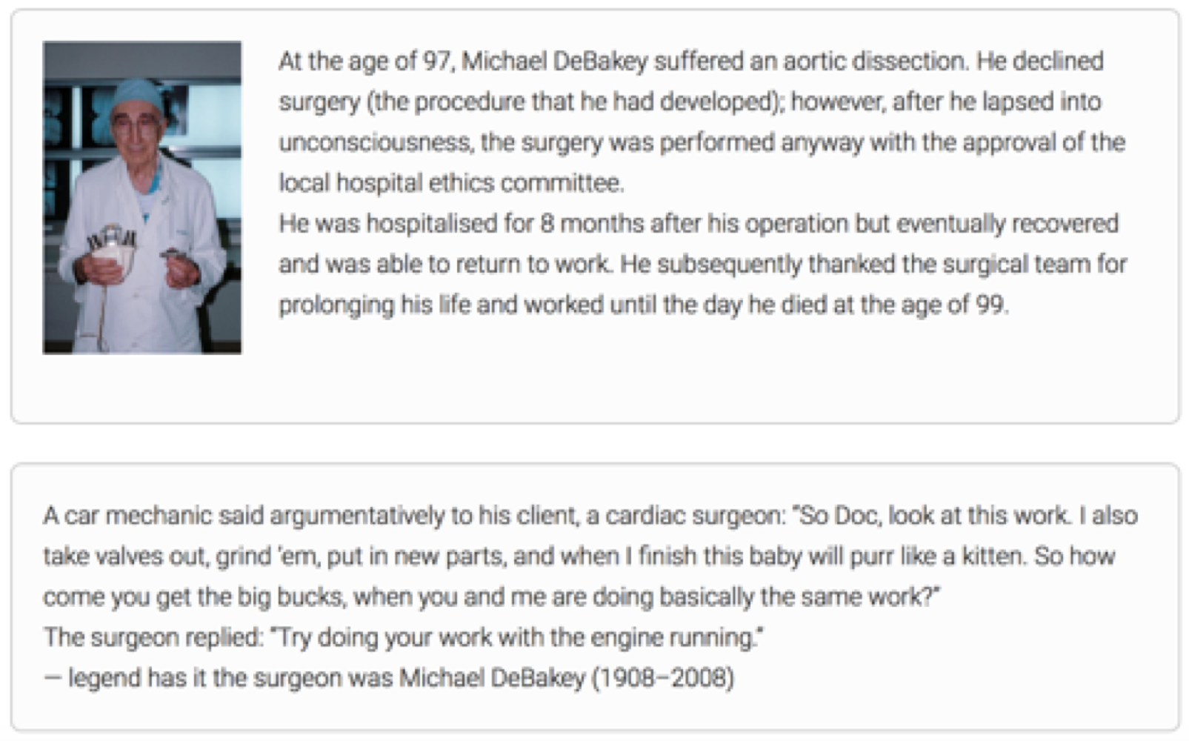
20
ANSWER:
What are the risk factors?
Inherited disease
Marfans syndrome, Ehlers-Danlos type IV, Turners syndrome
Aortic wall stress
• HTN 72%
• previous surgery, structural abnormality, iatrogenic (cath lab), syphilis, GC arteritis, cocaine
Reduced resistance aortic wall
• Increasing age
Pregnancy?
REVEAL:
Calendar

