Slide 1
FEEDBACK SURVEY
Tuesday, September 24, 2019

Slide 2
86
Total Responses
Date Created: Monday, October 15, 2018
Complete Responses: 86

Slide 3
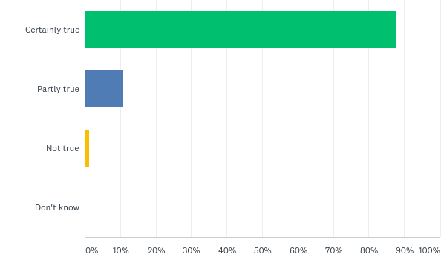
Q1: I feel that the people who saw me or my child listened to me
Answered: 83 Skipped: 3

Slide 4
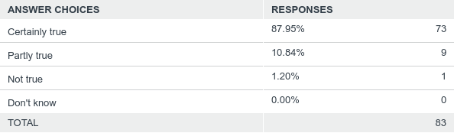
Q1: I feel that the people who saw me or my child listened to me
Answered: 83 Skipped: 3

Slide 5
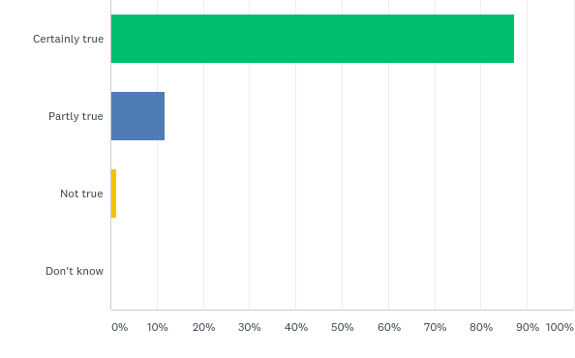
Q2: It was easy to talk to the people who saw me or my child
Answered: 86 Skipped: 0

Slide 6
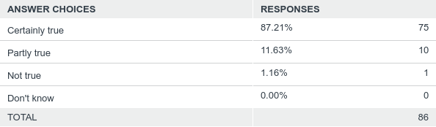
Q2: It was easy to talk to the people who saw me or my child
Answered: 86 Skipped: 0

Slide 7
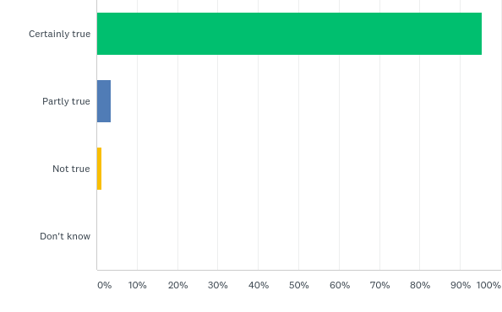
Q3: I was treated well by the people who saw me or my child
Answered: 86 Skipped: 0

Slide 8
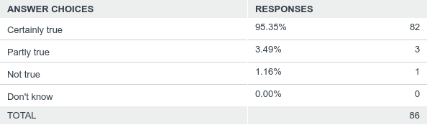
Q3: I was treated well by the people who saw me or my child
Answered: 86 Skipped: 0

Slide 9
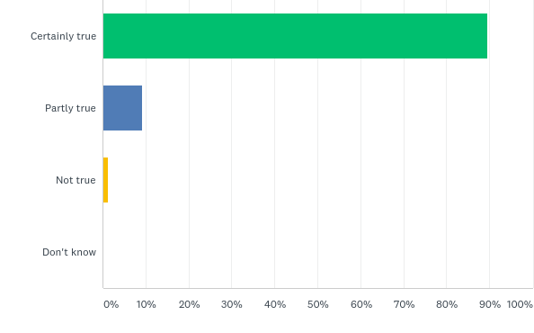
Q4: My views and worries were taken seriously
Answered: 86 Skipped: 0

Slide 10
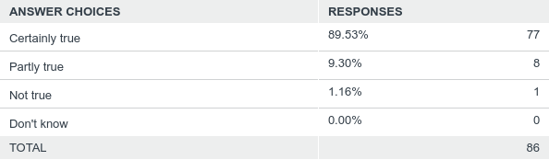
Q4: My views and worries were taken seriously
Answered: 86 Skipped: 0

Slide 11
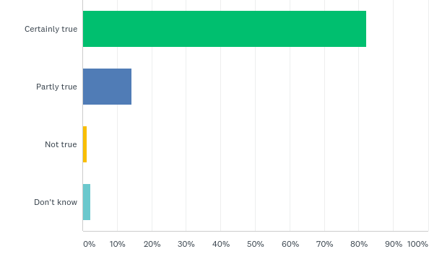
Q5: I feel the people here know how to help me or my child
Answered: 84 Skipped: 2

Slide 12

Q5: I feel the people here know how to help me or my child
Answered: 84 Skipped: 2

Slide 13
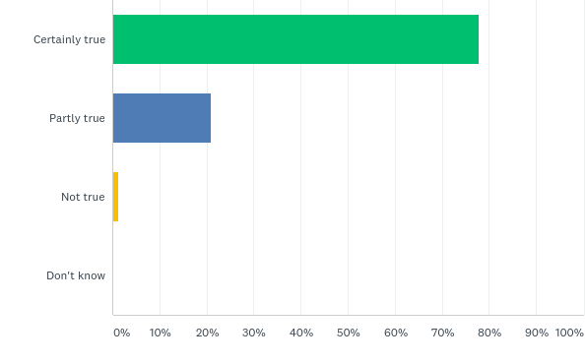
Q6: I have been given enough explanation about the help available here
Answered: 86 Skipped: 0

Slide 14

Q6: I have been given enough explanation about the help available here
Answered: 86 Skipped: 0

Slide 15
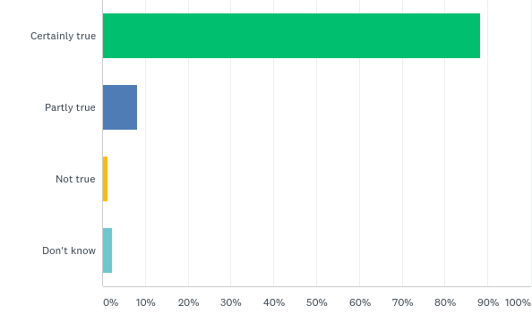
Q7: I feel that the people who have seen me or my child are working together to help us
Answered: 85 Skipped: 1

Slide 16

Q7: I feel that the people who have seen me or my child are working together to help us
Answered: 85 Skipped: 1

Slide 17
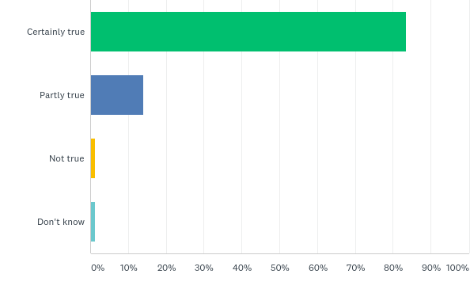
Q8: The facilities here are comfortable (e.g. waiting area)
Answered: 85 Skipped: 1

Slide 18
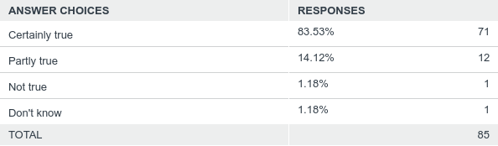
Q8: The facilities here are comfortable (e.g. waiting area)
Answered: 85 Skipped: 1

Slide 19
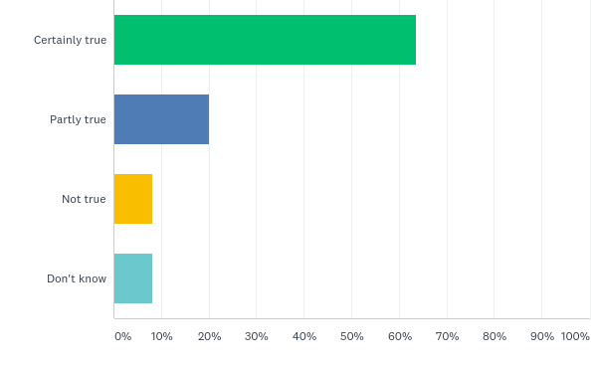
Q9: The appointments are usually at a convenient time (e.g. don’t interfere with school, clubs, college, work)
Answered: 85 Skipped: 1

Slide 20
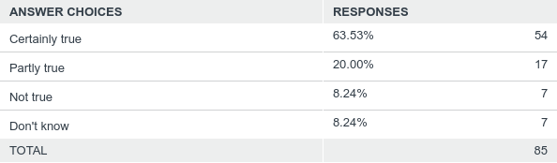
Q9: The appointments are usually at a convenient time (e.g. don’t interfere with school, clubs, college, work)
Answered: 85 Skipped: 1

Slide 21
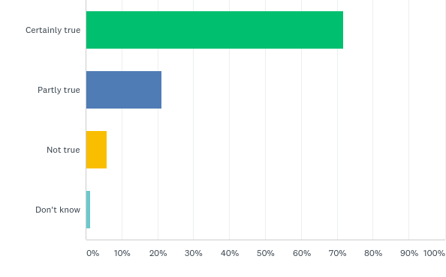
Q10: It is quite easy to get to the place where we have our appointments
Answered: 85 Skipped: 1

Slide 22
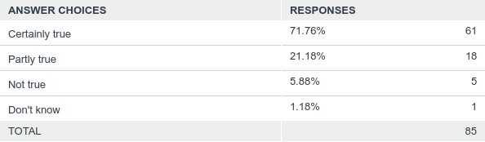
Q10: It is quite easy to get to the place where we have our appointments
Answered: 85 Skipped: 1

Slide 23
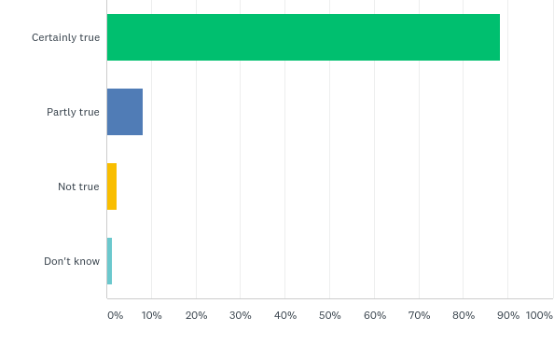
Q11: If a friend needed this sort of help, I would suggest to them to come here
Answered: 85 Skipped: 1

Slide 24

Q11: If a friend needed this sort of help, I would suggest to them to come here
Answered: 85 Skipped: 1

Slide 25
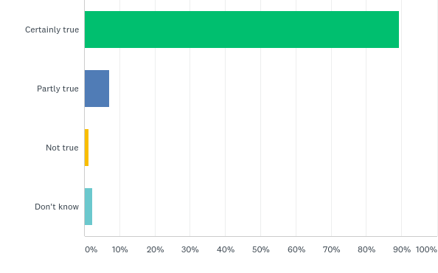
Q12: Overall, the help we have received here is good
Answered: 85 Skipped: 1

Slide 26
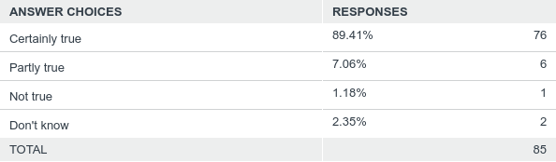
Q12: Overall, the help we have received here is good
Answered: 85 Skipped: 1

